Slide 1
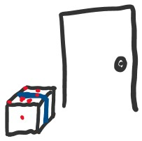

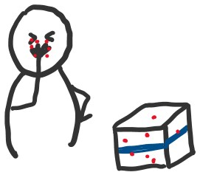
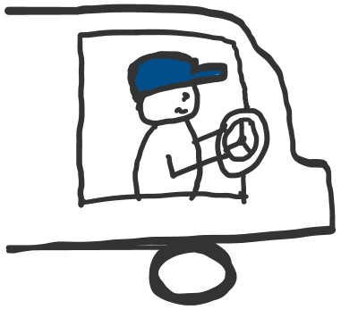

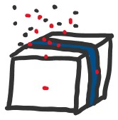


CORONAVIRUS AND PACKAGES: SAFETY TIPS
HOW CAN I BECOME INFECTED FROM A PACKAGE?
SICK DRIVER
COUGHS OR SNEEZES
DROPLETS LAND ON PACKAGE
PACKAGE DELIVERED SOON AFTER CONTAMINATION
I TOUCH CONTAMINATED SPOT
I TOUCH MY EYES, NOSE, OR MOUTH
HOW CAN I BREAK THE CHAIN?
1) DON’T TOUCH PACKAGE FOR 24 HOURS
2) WASH HANDS AFTER OPENING PACKAGE
OR
@JuliaLMarcus + @EpiEllie

